Slide 1
Production
Item Label Master & Item Warehouse Label Requests
DMS Guide

Slide 2
Table of Contents
Item Label Master….....................................................................................................3
Item Warehouse Label Requests...............................................................................12

Slide 3
Item Label Master
Back to the Table of Contents

Slide 4
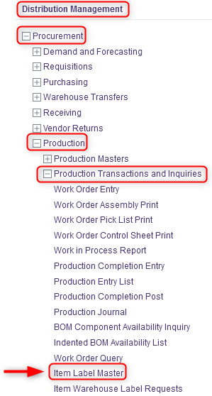
Item Label Master
This resource is used to make changes to the item description that will be printed on the item labels. To do this:
With a desktop computer, use the Distribution Management menu.
Select the Procurement resource.
Under Procurement, click on Production.
Under Production, click on Production Transactions and Inquiries.
Under Production Transactions and Inquiries, click on Item Label Master.

Slide 5
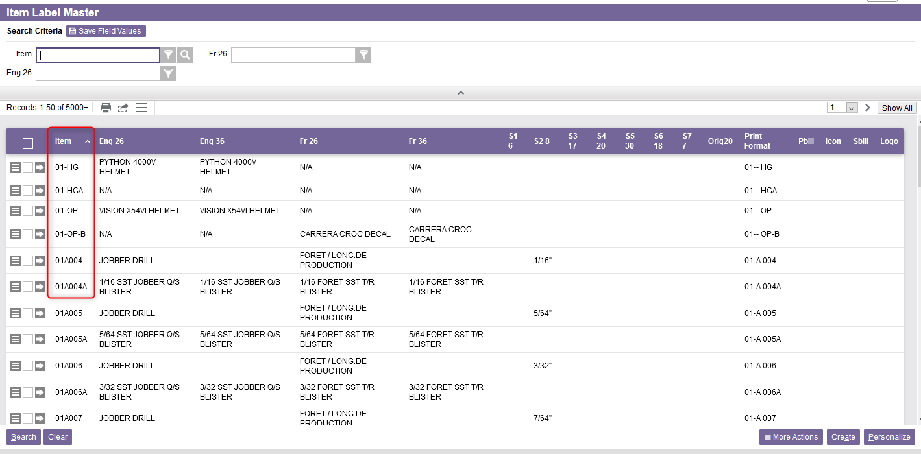
Item Label Master
Click enter in one of the search criteria fields. The list of all items will appear.

Slide 6
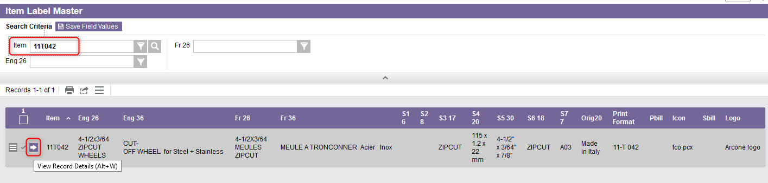
Item Label Master
Perform a search to retrieve the desired Item Label record you wish to update and click on View Record Details.

Slide 7
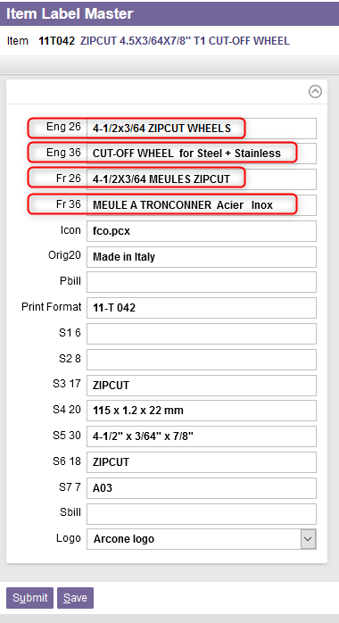
Item Label Master
From the detail view of the record, modify the available fields as required.
  8.1 Use the two Eng 26 and Eng 36 fields to update the English item description.
  8.2 In the same way, use the two Fr 26 and Fr 36 fields for the French item description.

Slide 8
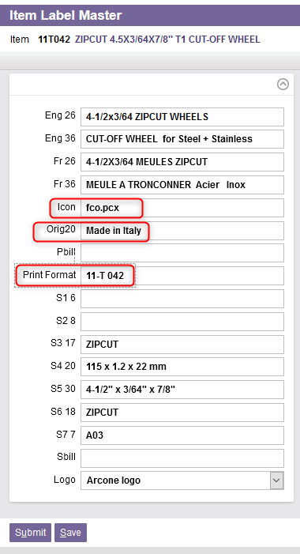
Item Label Master
8.3 Specify the image file format in the Icon field.
8.4 Enter the origin of the product in the Orig20 field.
8.5 Enter the Print Format to be used to print the item label.

Slide 9
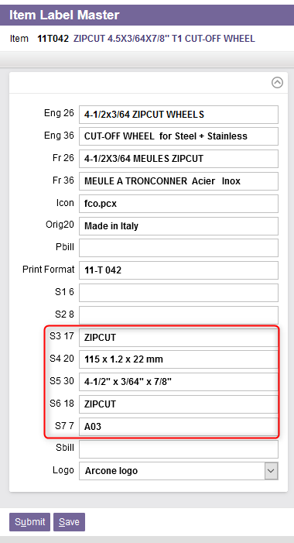
Item Label Master
8.6 Specify the other required information in the S3 17, S4 20, S5 30, S6 18, and S7 7 fields.

Slide 10
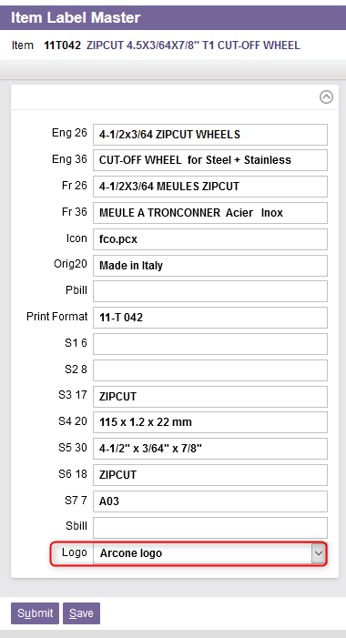
Item Label Master
8.7 Finally, if required, select the Logo that will be printed on the item label.

Slide 11
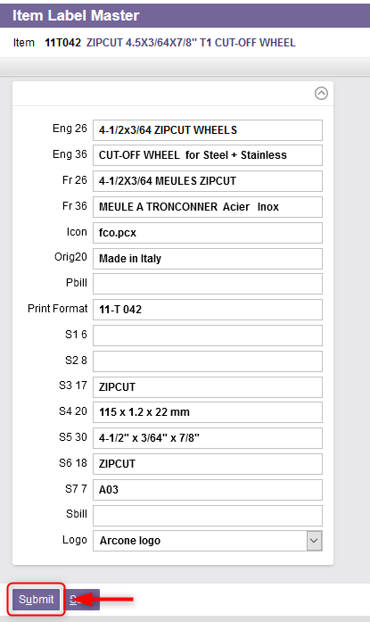
Item Label Master
Once all the required fields properly updated, click on Submit.
The changes have been saved in the system and will be applied to the item label once printed.

Slide 12
Item Warehouse Label Requests
Back to the Table of Contents

Slide 13
Item Warehouse Label Requests
The Item Warehouse Label Requests resource stores label print requests for item warehouses.
This resource allows you to add, modify, copy, delete the records in the item warehouse label requests table and to query the records in this table. Moreover, you can generate item warehouse label requests by specific item number and warehouse.
Therefore, this resource is used to create item labels for items that do not have one.

Slide 14
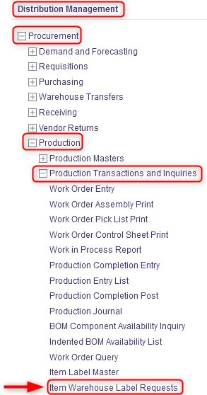
Item Warehouse Label Requests
To create item labels, do this:
With a desktop computer, use the Distribution Management menu.
Select the Procurement resource.
Under Procurement, click on Production.
Under Production, click on Production Transactions and Inquiries.
Under Production Transactions and Inquiries, click on Item Warehouse Label Requests.

Slide 15
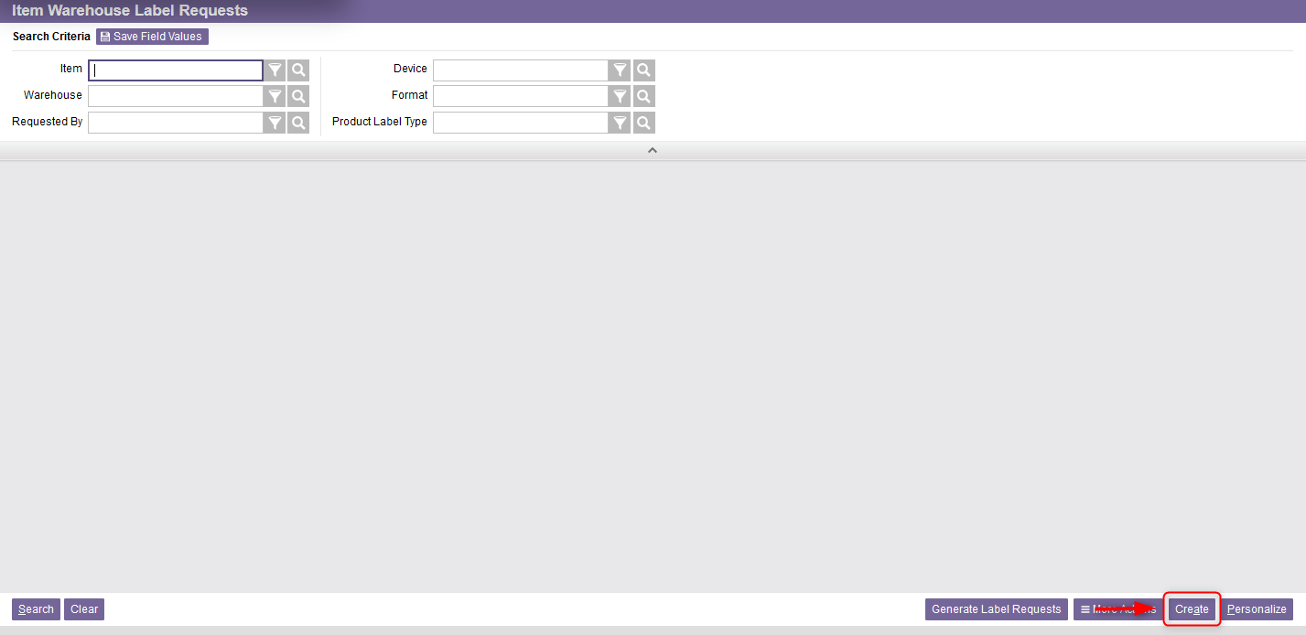
Item Warehouse Label Requests
From the new window, click on Create at the bottom right of your screen.

Slide 16
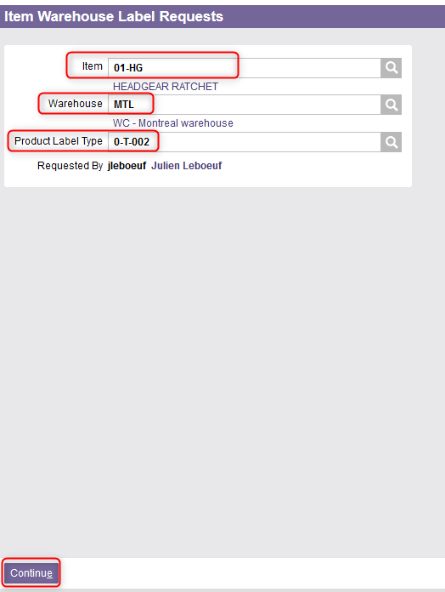
Item Warehouse Label Requests
A new window will appear. Enter the Item number.
Enter the Warehouse name (e.g., “MTL”).
Select the Product Label Type. Use the lookup button to retrieve the appropriate label type if needed.
Click on Continue.

Slide 17
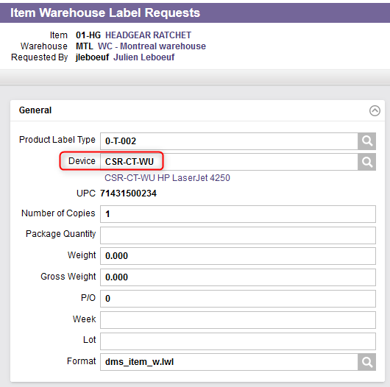
Item Warehouse Label Requests
A second window will appear.
In the General section, enter the output device code in the Device field (i.e., label printer). This is used by printing resources to select the output destination.

Slide 18
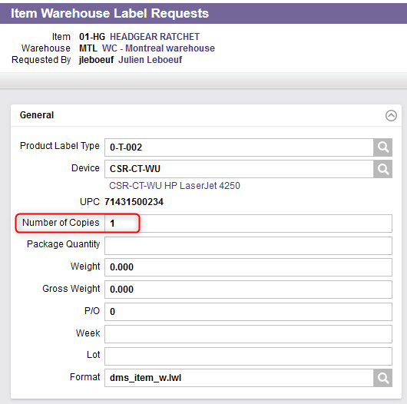
Item Warehouse Label Requests
Choose the number of labels to be printed for the item in the Number of Copies field. The default value is set to 1 but it may be overridden.

Slide 19
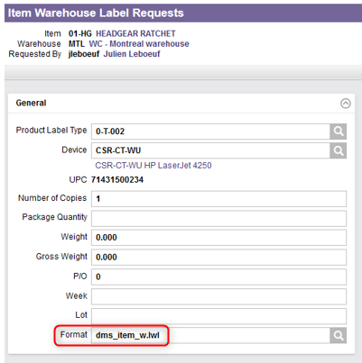
Item Warehouse Label Requests
Note that the Format field is a default value retrieved from the attribute value defined for the Item Warehouse Label Requests view in the view attributes table. No change is therefore required for this field.

Slide 20
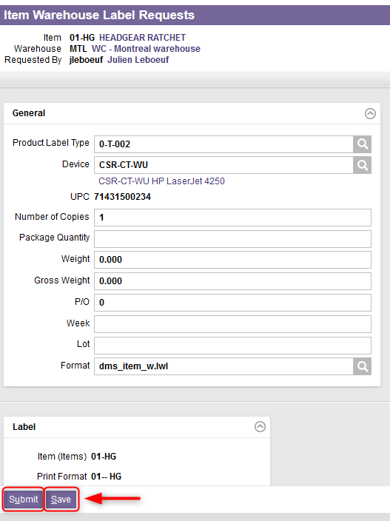
Item Warehouse Label Requests
Click on Save or Submit.

Slide 21
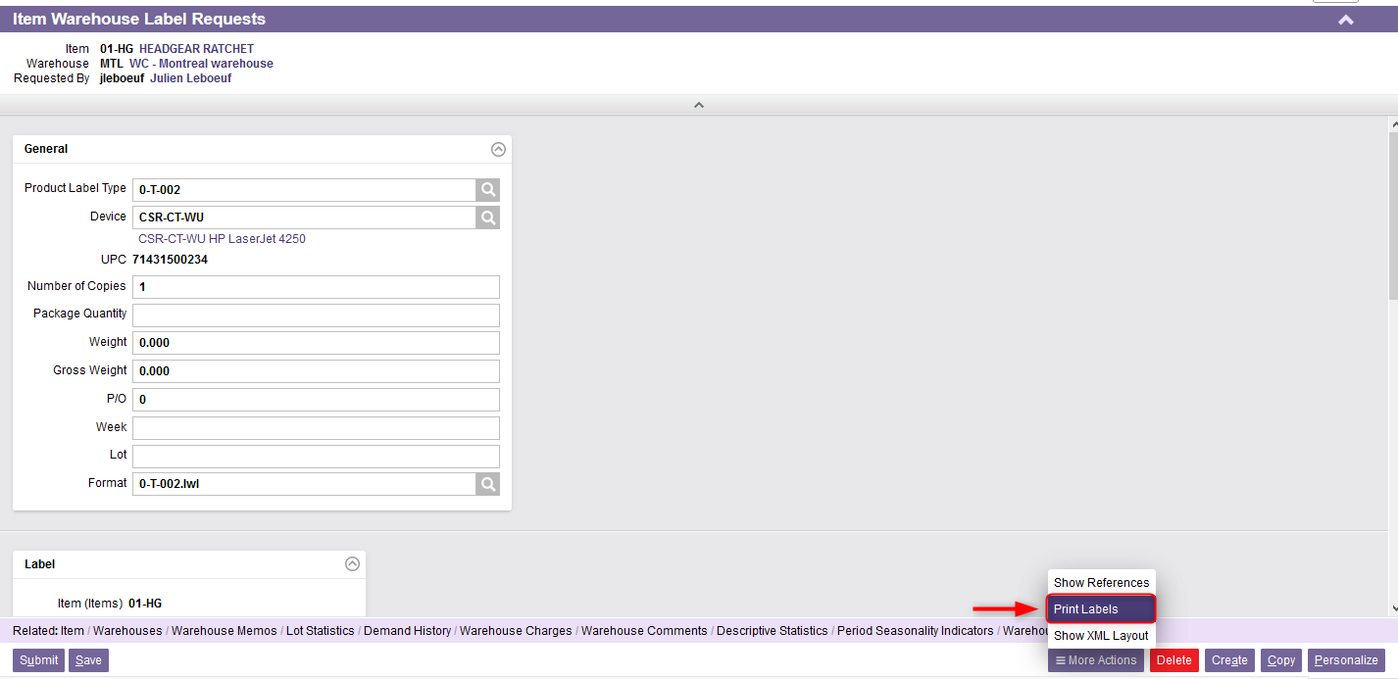
Item Warehouse Label Requests
If you clicked Save, then select the Print Labels action from the Actions Toolbar of the Details page.

Slide 22
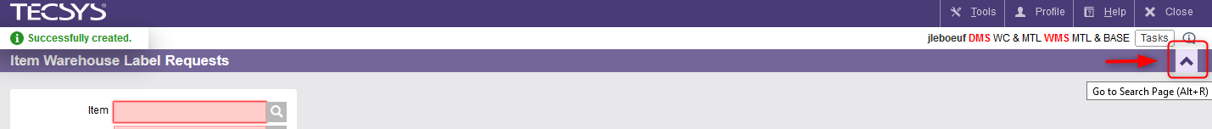
Item Warehouse Label Requests
If you clicked Submit:
  16.1 Then click the Go to Search Page action (i.e., the Up arrow) to return to the view's Search page.

Slide 23
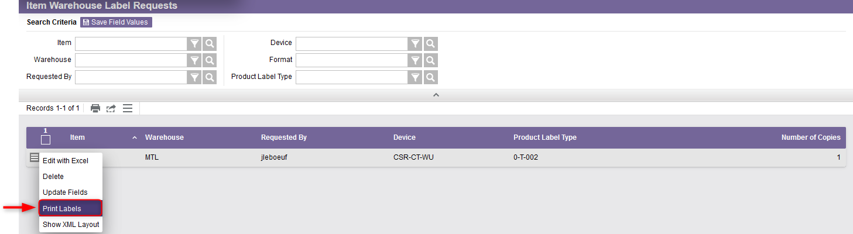
Item Warehouse Label Requests
  16.2 From the search page, click on the Use Record as Criteria for Action button and select the Print Labels action.

Slide 24
Item Warehouse Label Requests
Once the Print Labels action has been selected:
  The selected labels will be sent to the label printing software.
And once the labels are printed:
  The request record will be deleted from the item warehouse label requests table.

